Slide 1
Donor Disclosure – An Emerging Debate in Charity Regulation
2018 CLAANZ Conference – Melbourne, Thursday 2 August 2018
Krystian Seibert – Industry Fellow, Centre for Social Impact, Swinburne University of Technology

Slide 2
General consensus around transparency
  Registered charities should be transparent around the operations, governance and finances → Purpose of ACNC reporting
  Partisan political actors, be they political parties, candidates or third parties, should be transparency about their sources of funding → Purpose of annual returns to the AEC
  Mandatory requirements, specified in ACNC and electoral legislation

Slide 3
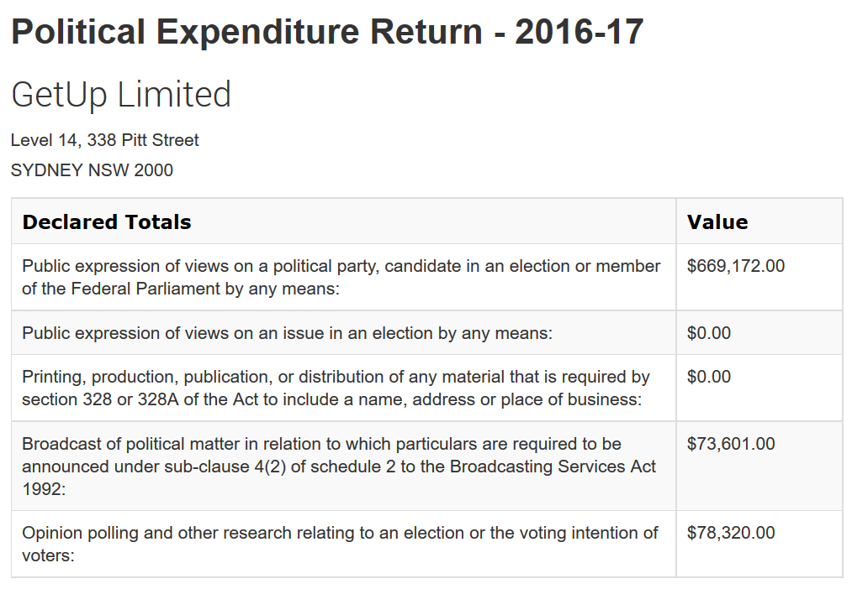

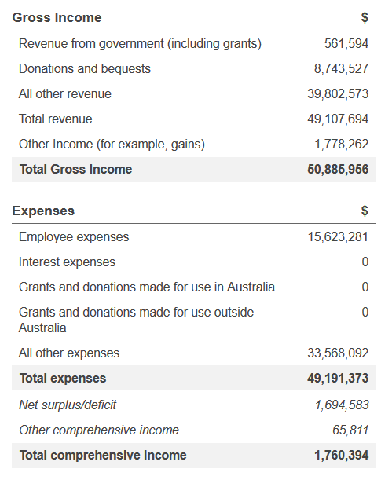
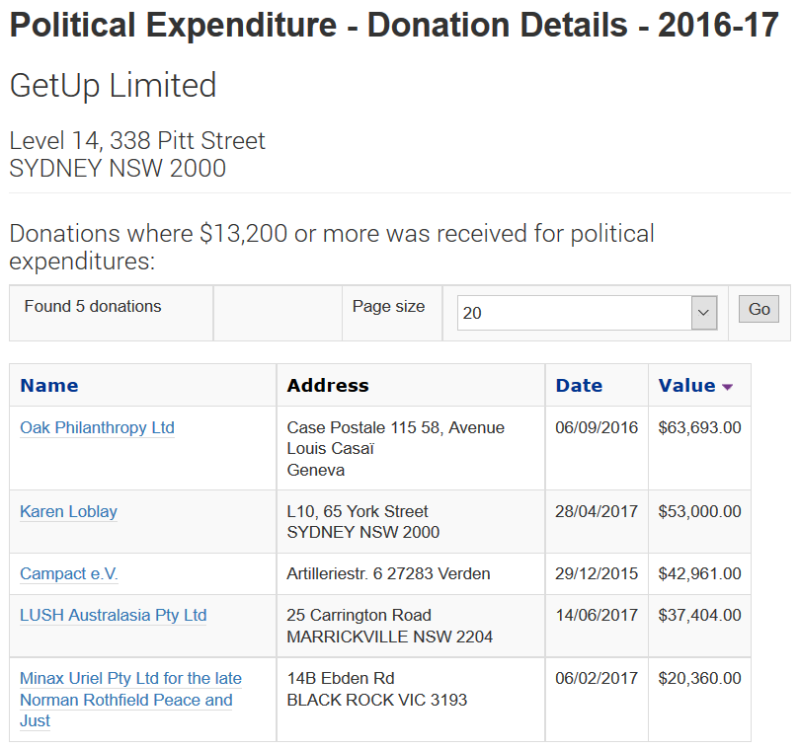

Slide 4
Source of disagreement
  How much reporting should be required of non-partisan political actors, such as charities undertaking advocacy?
  That’s the debate we’re having about the proposed changes to the Electoral Act
  Increased attention on the role of think tanks, both here and overseas
      Most of them are charities
      That’s what I want to focus on

Slide 5
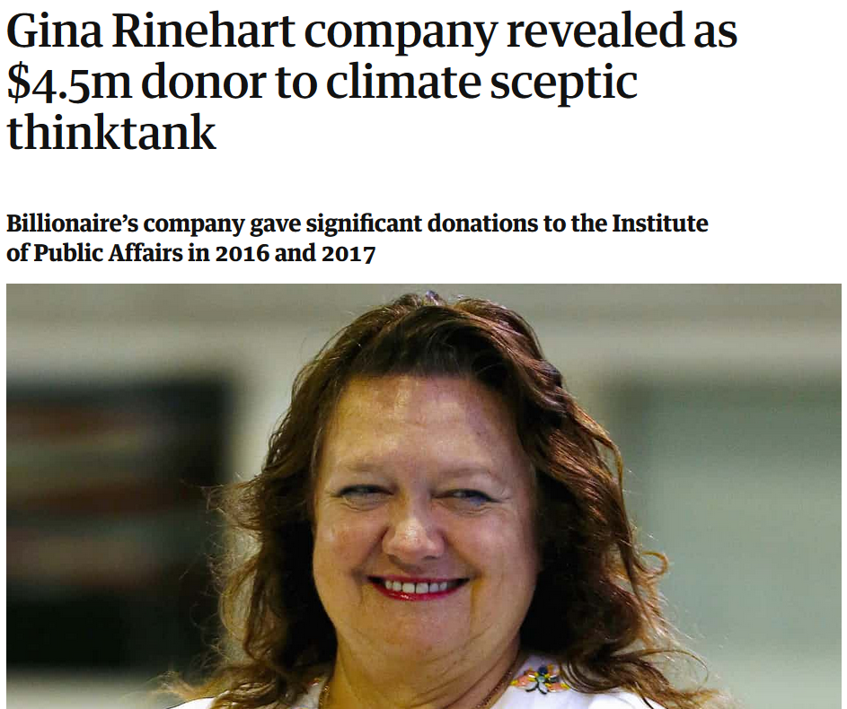

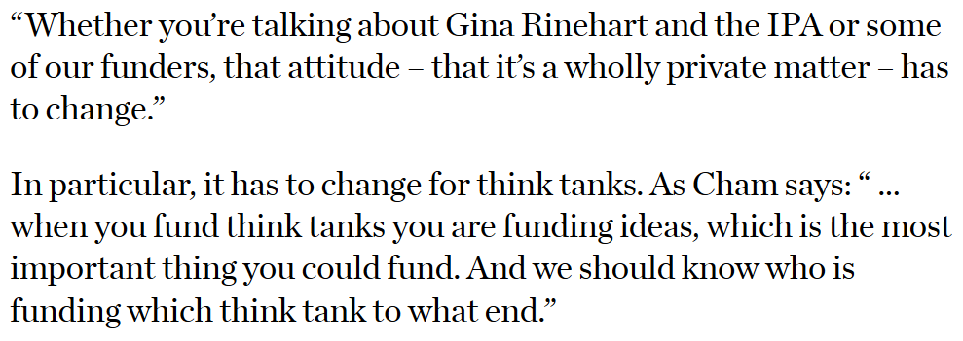

Slide 6
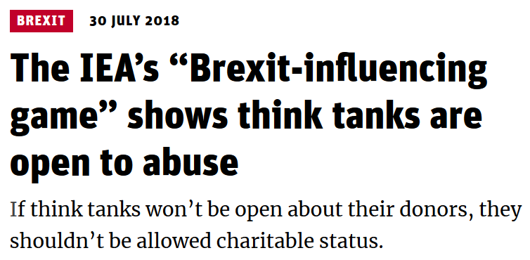
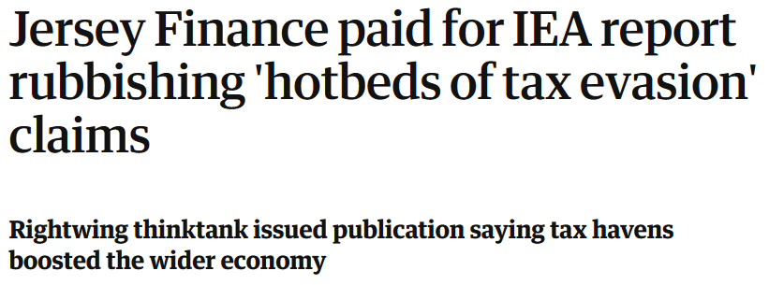

Slide 7

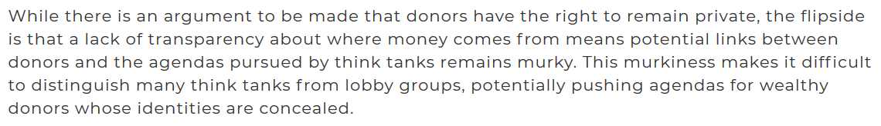
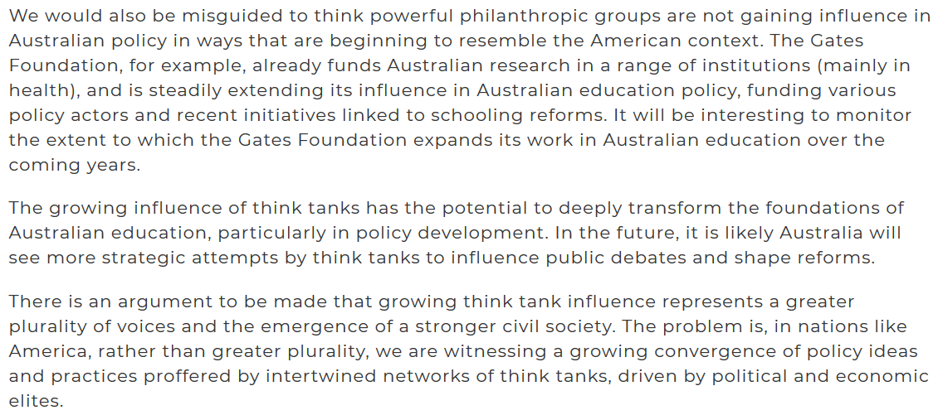

Slide 8

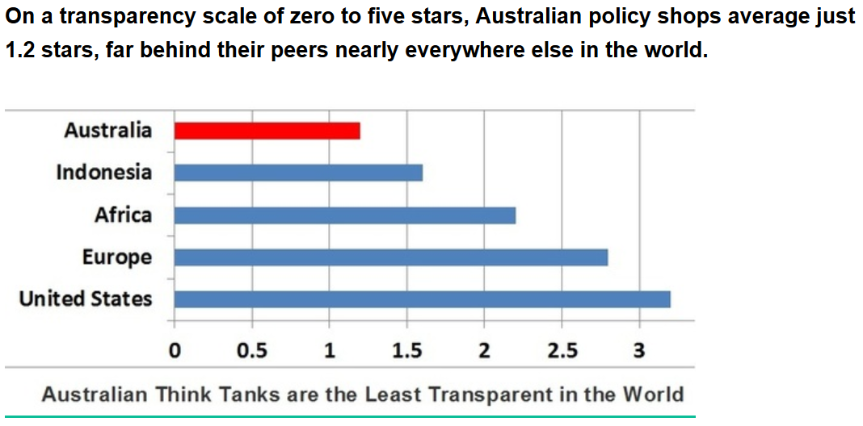

Slide 9
Is there a case for mandatory donor disclosure by think tanks in Australia?
Buckley v. Valeo (1976)
‘The interest in alleviating the corrupting influence of large contributions is served by . . . contribution limitations and disclosure provisions . . .‘
Citizens United v. Federal Election Commission (2010)
‘With the advent of the Internet, prompt disclosure of expenditures
can provide shareholders and citizens with the information needed
to hold corporations and elected officials accountable for their posi-
tions and supporters. Shareholders can determine whether their
corporation’s political speech advances the corporation’s interest
in making profits, and citizens can see whether elected officials
are “in the pocket” of so-called moneyed interests.’
Versus…
NAACP v. Alabama (1958)
‘It is hardly a novel perception that compelled disclosure of affiliation with groups engaged in advocacy may constitute as effective a restraint on freedom of association as [other] forms of governmental action . . .’

Slide 10
Does mandatory disclosure tell us that much?
  A think tank, or any other organisation advancing public debate on policy issues, will generally be supported by people who agree with its policies
  Is anybody surprised that Gina Rinehart supports the Institute of Public Affairs – does anybody think that if she didn’t support it, it adopt a different position on climate change?
  If it was transparent, would its positions become more compelling?

Slide 11
  Perhaps voluntary disclosure is sufficient after all?
  Policy makers, the media and other stakeholders who are influenced (or not influenced) by think tanks can discount the views of those which they don’t think are sufficiently transparent
  If you’re suspicious of the intentions of a think tank, then ignore its proposals!
A half way house on donor disclosure?
An ‘if not, why not’ requirement
Then let policy makers, the media and other stakeholders make up their own minds

